Slide 1

Intro to DPR and the Air Program: Regulation of Pesticides
Leia Bailey
Chief Deputy Director
Madison Le
Deputy Director – Monitoring and Mitigation Division

Slide 2
Agenda
Introduction to DPR
DPR's Work with CARB and OEHHA
Air Program Overview
AB 617 Collaboration and Case Studies

Slide 3
Introduction to DPR

Slide 4
Mission
We protect human health and the environment by fostering sustainable pest management and regulating pesticides.
Vision
Pest management that is safe, effective, and sustainable for all Californians and our environment.

Slide 5

Our Commitment To Equity And Environmental Justice
California continues to lead on important policies and initiatives to advance equity and opportunity for all.
DPR is pursuing a deliberate, inclusive, and equity-centered approach in our strategic plan and through our ongoing work protecting human health and the environment.
| 5

Slide 6
What We Do:
Regulate Pesticides
Evaluating pesticides for risks and impacts to people and the environment before they are registered for use in California
Continuously evaluating pesticides
and mitigating risks
Enforcing pesticide use laws with County Agricultural Commissioners

Slide 7
What We Do:
Foster Sustainable Pest Management (SPM)
Sustainable Pest Management (SPM) is a holistic, whole-system approach applicable in agricultural and other managed ecosystems and urban and rural communities that builds on the existing practice of Integrated Pest Management (IPM) to include the wider context of three sustainability pillars:
Human Health and Social Equity: mitigate the impacts that pesticides
have on communities.
Environmental Protections: understand linkages between pesticides and broader issues, like water conservation, biodiversity, soil health, and climate.
Economic Vitality: a broader consideration of economic benefits and impacts.

Slide 8
DPR Programs
PROGRAMS
Environmental Monitoring
Worker Health & Safety
Human Health Assessment
Pesticide Registration
Enforcement
Pesticide Evaluation
Integrated Pest Management

Slide 9
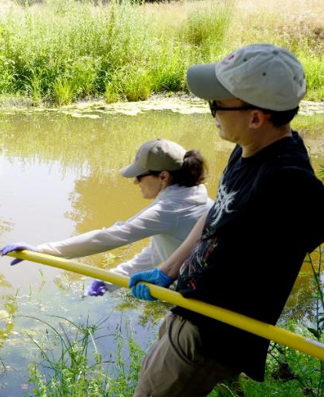
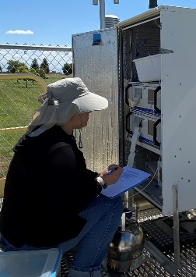
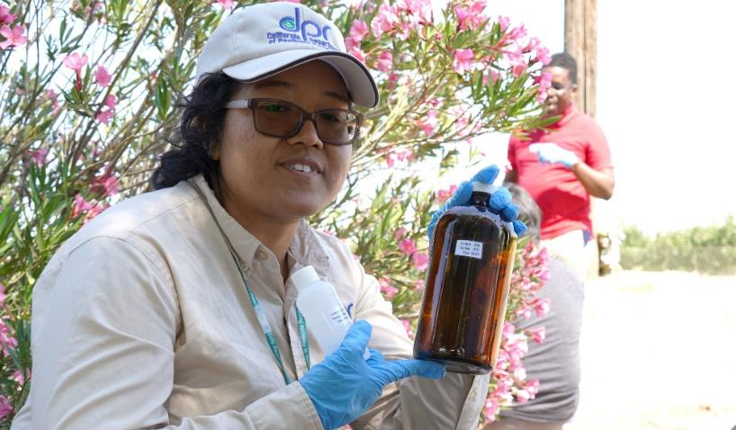
Environmental Monitoring
Air monitoring
Groundwater monitoring
Surface water monitoring

Slide 10
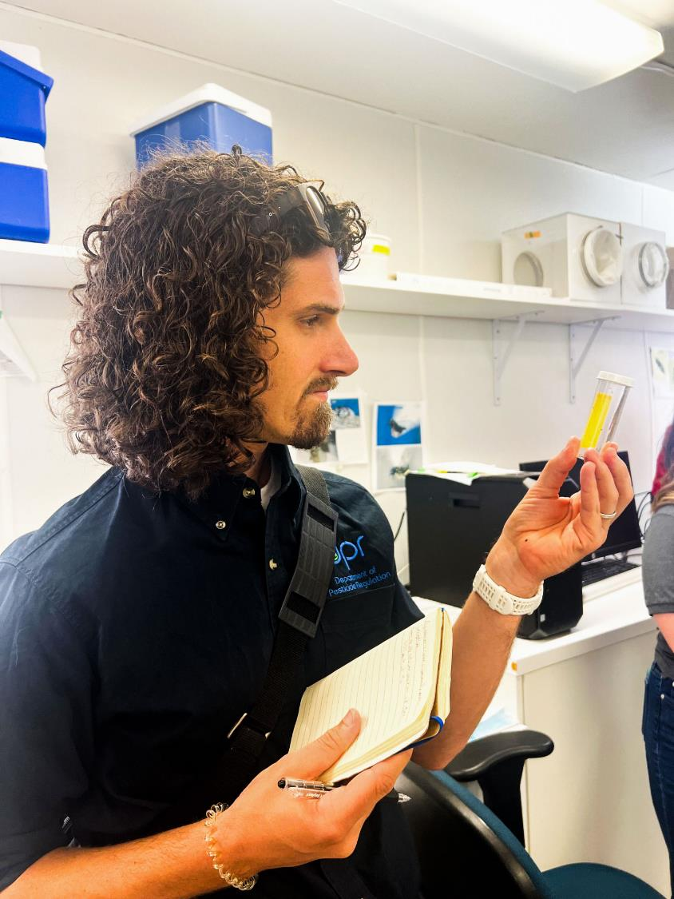
Advancing Worker Health and Safety
DPR develops regulations to protect the health and safety of those working with or near pesticides
DPR tracks reported illnesses and conducts exposure studies to better inform regulatory actions and mitigation measures

Slide 11
DPR Actions to Mitigate Pesticide Risks
When DPR identifies risks associated with pesticide, DPR can:
  Conduct a rulemaking process to restrict use or add requirements for the use of a pesticide, designate a pesticide as a restricted material to require additional restrictions and oversight for use
  Work on changes to a pesticide's label (the label is the law)
  Best management practices
  Cancellation of the pesticide
  Current DPR mitigation priorities: Continuous Evaluation and Mitigation Update - Department of Pesticide Regulation

Slide 12
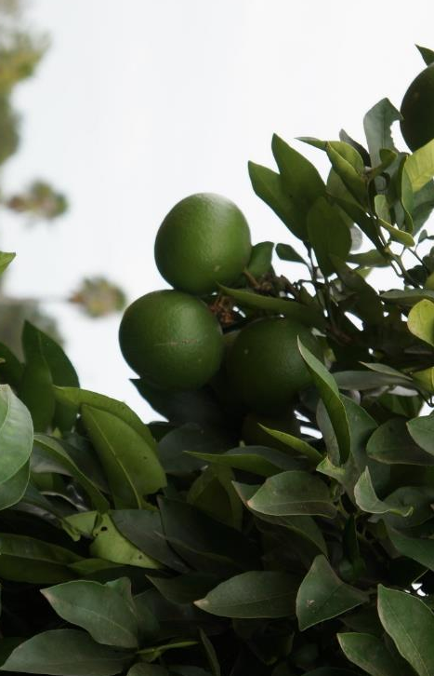
Scientific Prioritization and Review Committee
(SPARC)
Advise DPR actions related to identifying
and mitigating risks to human health and the environment resulting from pesticide use
Provide public, transparency and scientifically
informed conversation about the priorities
at DPR for continuous evaluation program
and mitigation actions
Anticipated first meeting in 2026
| 12
| 12

Slide 13
Enforcing Pesticide Use Laws and Regulations
DPR oversees pesticide use enforcement in California to protect people and the environment
County agricultural commissioners (CACs) and combined 500 field inspectors and staff conduct pesticide use enforcement on the ground across the state
DPR provides guidance and supports consistent and effective enforcement through oversight inspections of CACs, data review, evaluation of county programs and training.
CACs conduct inspections, investigate incidents, certify applicators, issue local permits and support compliance for growers and applicators
Data on enforcement is available on DPR's website

Slide 14

2026 Sustainable Pest Management Grants
Annual grants to support SPM research and adoption.
This year: awarded 8 grants (~$5 million)
Over $1.8 million for rodent management alternatives through 2 projects, including one focused on protecting irrigation
Over $800,000 to a project focused on biocontrol for and insecticide resistance in Diamondback moth
2 other projects focus on alternatives to weed management and another on an alternative to fumigation

Slide 15
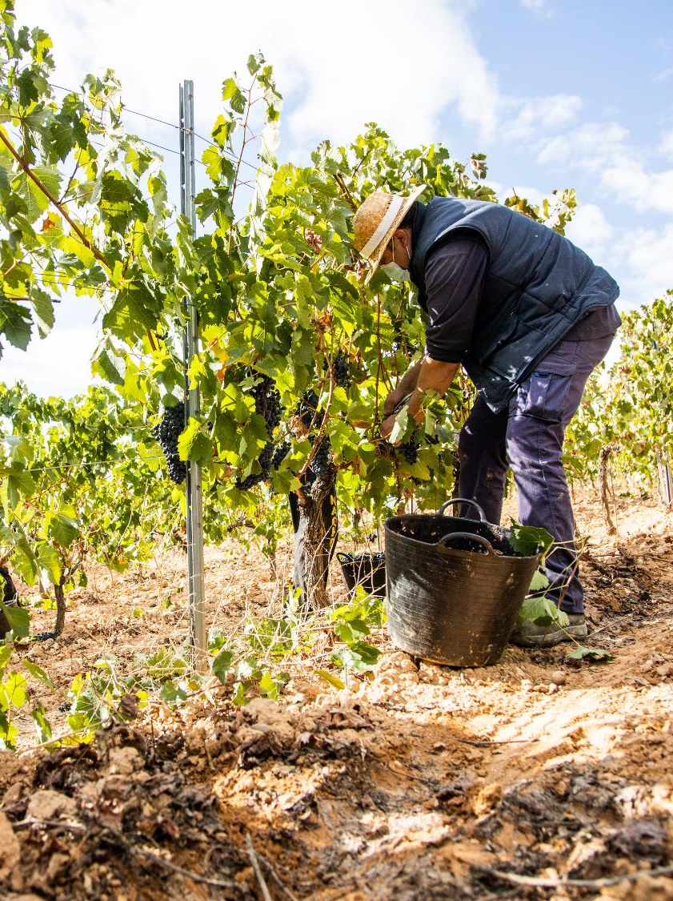
SPM Advisory Committee
Expand consultation and conversation
to support SPM implementation
Committee will support development of key SPM metrics, and explore procurement and retail strategies that incorporate SPM
First meeting anticipated in 2026

Slide 16
Independent Fumigant Alternatives Study
Conducted by the California Council on Science and Technology (CCST)
Soil Fumigants (1,3‑D & Chloropicrin)
Evaluated available alternatives
No single replacement; combinations may work for specific uses
Structural Fumigation (Sulfuryl Fluoride)
Reviewed alternatives for whole‑structure treatments
Localized options effective; few full‑structure alternatives identified
Post‑Harvest Commodity Fumigation
Expert convening on alternatives to major post‑harvest fumigants
Identified exposure concerns, viable emerging tools, and research gaps
Pre-plant Fumigants (Methyl bromide, dazomet, metam-sodium,
& metam-potassium)
Expected later this year

Slide 17
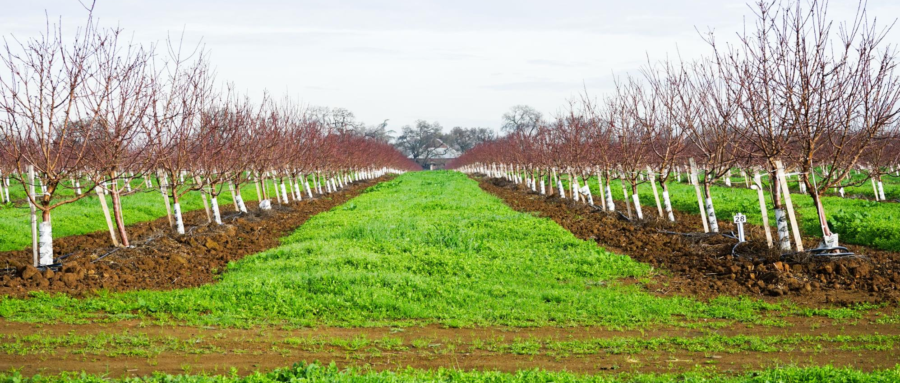
2024-2028 Strategic Plan Goals
1
2
3
4
Increase Access to Safe, Effective, Sustainable Pest Management
Foster Engagement, Collaboration & Transparency
Promote Organizational Excellence and Innovation
Track, Evaluate, and Enforce Safe Pesticide Use

Slide 18
2026 Progress Update Highlights
Advancing sustainable pest management through interagency coordination
Strengthening enforcement
Modernizing
pesticide registration
Building language access tools
Expanding community‑driven air
and water monitoring
Improving public access to data

Slide 19
DPR Coordination and Collaboration with
OEHHA, CARB, Air Districts

Slide 20
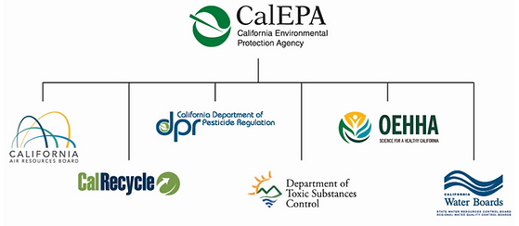
California Environmental Protection Agency

Slide 21

DPR and OEHHA
DPR works with OEHHA on peer review of risk and exposure assessments conducted by DPR. These assessments inform mitigation action to regulate the use of pesticides.
OEHHA and DPR have joint-and-mutual responsibility for developing regulations specific to worker safety (for example, 1,3-D occupational bystander regulations effective Jan. 1, 2026).
Separate from DPR programs, OEHHA reviews pesticides under the Proposition 65 Program and the Air Toxics Hot Spots Program.

Slide 22

DPR and CARB
CARB provides technical information to DPR through the department's Pesticide Registration and Evaluation Committee
CARB provides consultative review of DPR regulations relative to Toxic Air Contaminants through the TAC Workgroup
DPR provides CARB with an annual database of Volatile Organic Compounds
DPR supports CARB/AQMD work through AB 617 Community Emissions Reduction Plans where pesticides are of interest or included on plans
This information and technical work with CARB can inform DPR's approach to mitigate pesticide impacts through use restrictions or other mitigation measures

Slide 23
DPR and Air Districts
Consultation with air pollution control or air quality management districts in affected counties occurs for pesticide TACs
  For example, DPR consulted with AQMDs via CAPCOA for both the1,3-D occupational and non occupation bystander regulations
DPR regulates the use of pesticides in California to protect people and the environment, informed by DPR's scientific assessments to provide technical basis for regulations
DPR can provide technical support and assistance to air districts on work related to emissions based on the technical basis provided through OEHHA's Air Hot Spots Program

Slide 24
Environmental Monitoring:
Air Program Overview

Slide 25
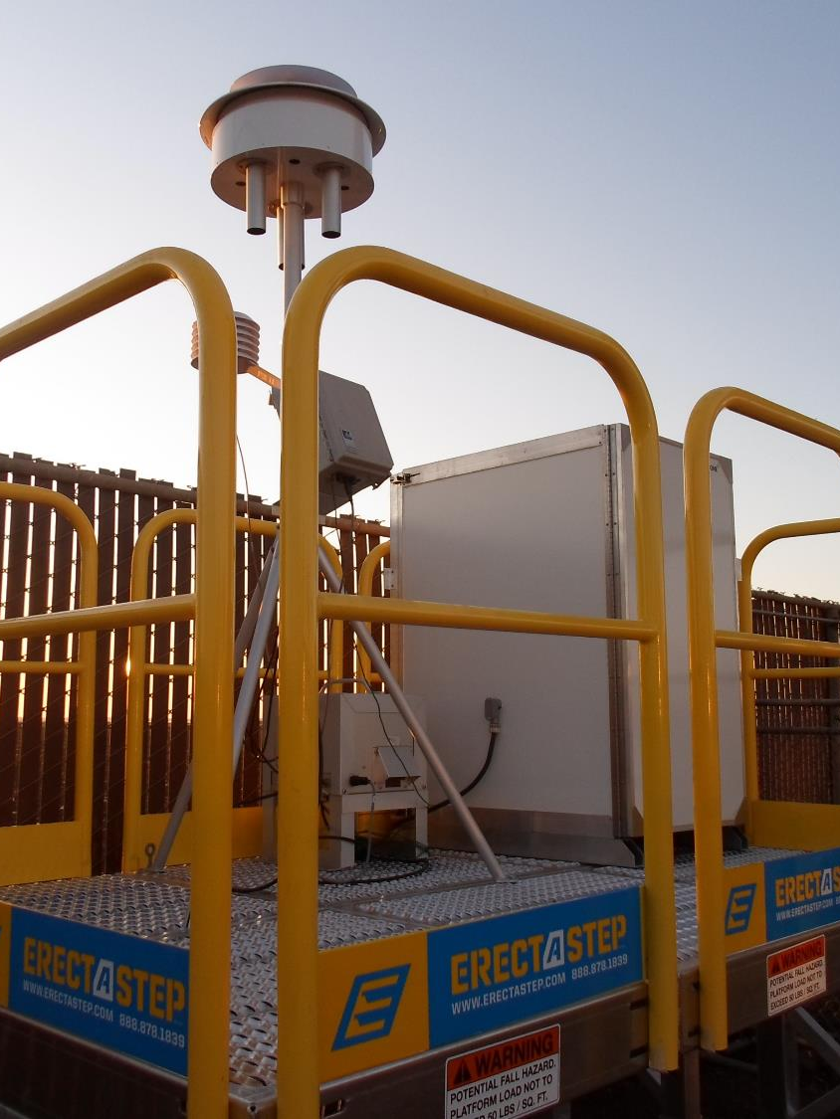
Air Program Overview
Air Monitoring Network (AMN): Expansion
Toxic Air Contaminants (TACs): Pesticides
Fumigants: Restricted Use Materials
Volatile Organic Compounds (VOC): Emissions Inventory
Pesticide Air Monitoring Results (PAMR) Database and Reports

Slide 26
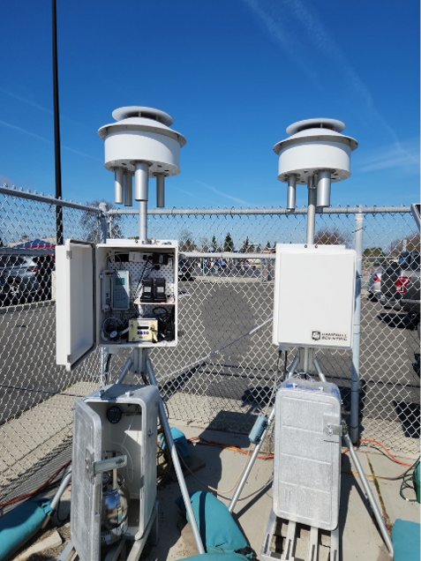
Air Monitoring Network (AMN)
AMN stations provide DPR with data on pesticides in ambient air that allows for the long-term assessment of potential pesticide exposures in agricultural communities with high pesticide use.
The AMN monitors 35 pesticides and 5 breakdown products in the ambient air weekly.
Support continuous evaluation and evaluate the efficacy of existing mitigation measures.

Slide 27
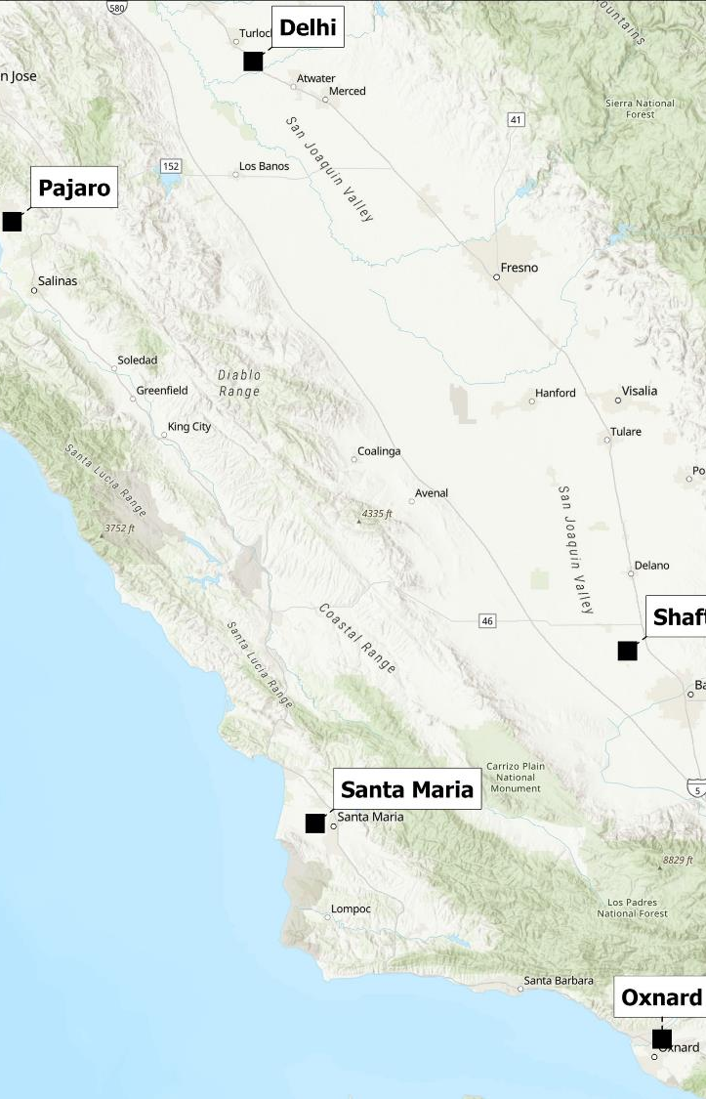
AMN Locations
Currently, there are five AMN sites and one planned expansion (6 total):
Oxnard (Ventura County)
In operation since October 2011
Santa Maria (Santa Barbara County)
In operation since August 2010
Shafter (Kern County)
In operation since February 2011
Pajaro (Monterey County)
  Location moved
  in January 2026
  In operation in
  that township since
  November 2011
Delhi (Merced County)
  Recently expanded in January 2026
  1,3-D monitoring in operation since December 2016
Fresno County –planned expansion/relocation
1,3-D monitoring in operation since December 2016

Slide 28
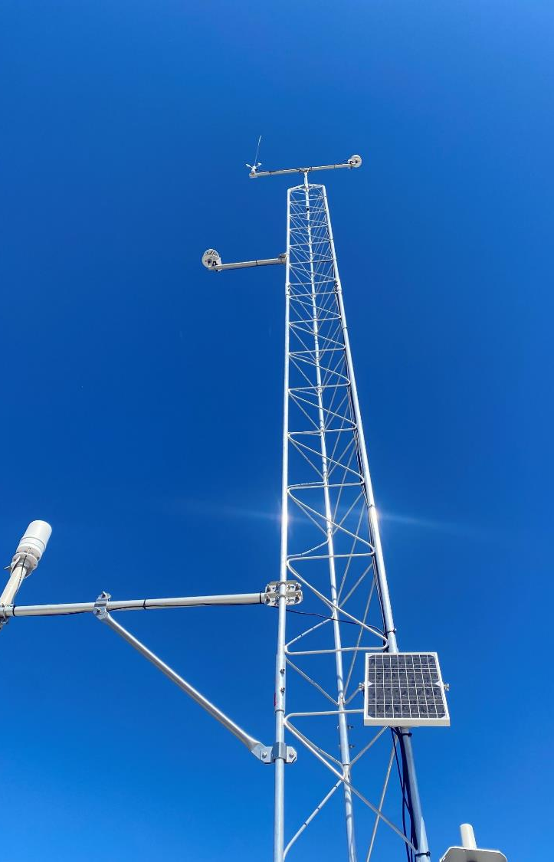
AMN Expansion
DPR received additional funding in the 2024 Budget Act to permanently expand its ambient air monitoring efforts.
Expansion proposal includes:
Conversion of 1,3-D only stations
New mobile monitoring platform
4 new monitoring stations
The target date for expansion is by the end of 2027
Currently reviewing public comment submissions (comment period ended 5/11/26)

Slide 29
AMN Expansion: Five Counties Prioritized
County | Number of Top-50 Communities within the County | Priority Category by DPR
Tulare | 27 | 1
Stanislaus | 13 | 2
Imperial | 5 | 3
Siskiyou | 6 | 4
San Joaquin | 2 | 5

Slide 30
Toxic Air Contaminants: Pesticides
DPR has statutory authority to evaluate and control pesticides as Toxic Air Contaminants (TAC).
1
Pesticides are evaluated through the standard risk assessment process to determine whether the pesticide should be designated as a TAC.
2
DPR prepares a TAC evaluation report that is reviewed by OEHHA, CARB, and a Scientific Review Panel.
3
Once an evaluated pesticide is listed as a TAC, it enters the mitigation phase of the TAC program.

Slide 31
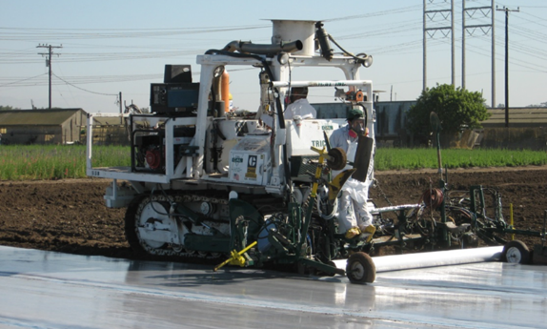
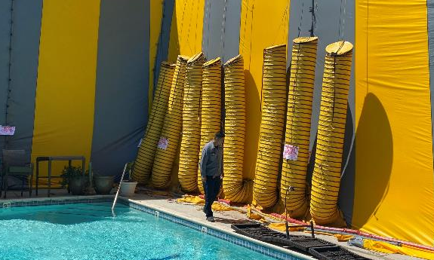
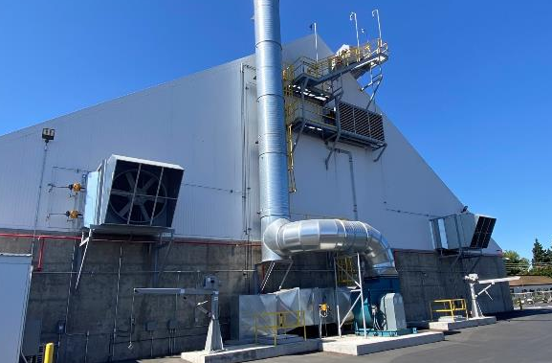
Fumigants
Fumigants are designated as “restricted-use materials” specific state requirements
  Restricted Materials Permit issued by CAC, applications must be made by certified applicator, agricultural applications require notice of intent (NOI), certain mitigation measure (buffer zones, application method) and specific reporting/recordkeeping
Fumigant Types
  Commodity fumigants: Sulfuryl Fluoride, Phosphine, and, for QPS purposes, MeBr.
  Field fumigants: 1,3-D, chloropicrin, MITC, and, for QPS purposes, MeBr.
  Structural fumigant: Sulfuryl Fluoride
Recent 1.3-D Regulations:
  1,3-D non-occupational bystander regulations went into effect in January 2024
      Restriction in application size and rate, low emission methods, higher soil moisture, setback distance
  1,3-D occupational bystander regulations went into effect in January 2026
      Buffer zone, additional restrictions on application methods

Slide 32
VOC Emissions Inventory
DPR is responsible for tracking and reducing volatile organic compound (VOC) emissions from agricultural and commercial structural pesticide products in federal nonattainment areas (NAAs).
DPR produces an annual report called the VOC Inventory to track whether the NAAs are in compliance with State Implementation Plan (SIP) goals.
DPR shares the pesticide VOC Inventory data with the California Air Resources Board (CARB) on an annual basis.
DPR has and can develop regulations to keep the NAAs in compliance with the goals.
  Certain high-VOC non-fumigant products are prohibited during the ozone season in the San Joaquin Valley NAA.
  DPR requires the use of low-emission fumigant products during the ozone season in several NAAs.

Slide 33
Pesticide Air Monitoring Results (PAMR)
Database and Reports
PAMR database: Data from pesticide air monitoring studies conducted throughout California
  AMN (Study 257): Data for 40 pesticides monitored at AMN stations located in Watsonville (recently relocated to Pajaro), Shafter, Oxnard, Santa Maria, and Delhi)
  1,3-D (Study 309): Data for 1,3-D monitored Parlier location
  Data posted on quarterly basis and reported as individual pesticide air concentrations for 24 hours, 4-13 weeks, 1-year and percent of its DPR thresholds
Reports:
  Annual AMN Report: Provides a comprehensive overview of monitoring data by comparing results to screening levels and regulatory targets, as well as evaluating trends relative to previous years.
  1,3-D Annual Report: Focuses on statewide 1,3-D monitoring data, compares results to screening level and regulatory targets, and evaluates trends relative to previous years.
PAMR website: https://www.cdpr.ca.gov/environmental-monitoring/air-monitoring/

Slide 34
AB 617 Collaboration and Case Studies

Slide 35
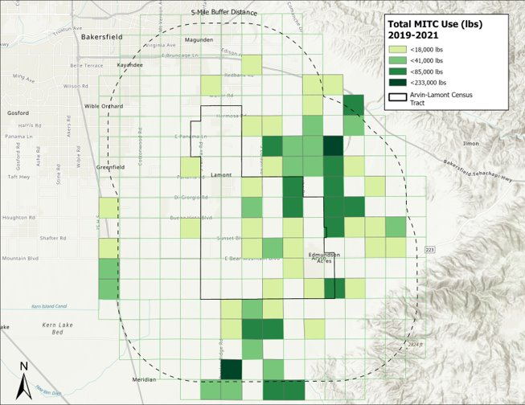
Collaboration on AB617 Communities
Arvin-Lamont
CARB monitored for two fumigants in June – September 2024.
DPR, CARB, and OEHHA are currently analyzing the data.
A collaborative presentation is targeted for Q3 2026.
Eastern Coachella Valley
CARB monitored for three fumigants in late November 2022 – February 2023.
DPR and OEHHA analyzed the data.
DPR and OEHHA collaboratively presented the data to the community in two presentations in 2025.
Shafter
DPR has engaged with the Shafter AB617 community and coordinated extensively with the SJ AQMD since 2018.
The SprayDays concept was initiated by the Shafter CAC.
DPR engages the CSC, along with the Arvin-Lamont CSC, often, by providing monthly updates and presentations on pesticide-related topics.
  DPR has provided overviews on the AMN Shafter monitoring results to the CSC.
| 35

Slide 36
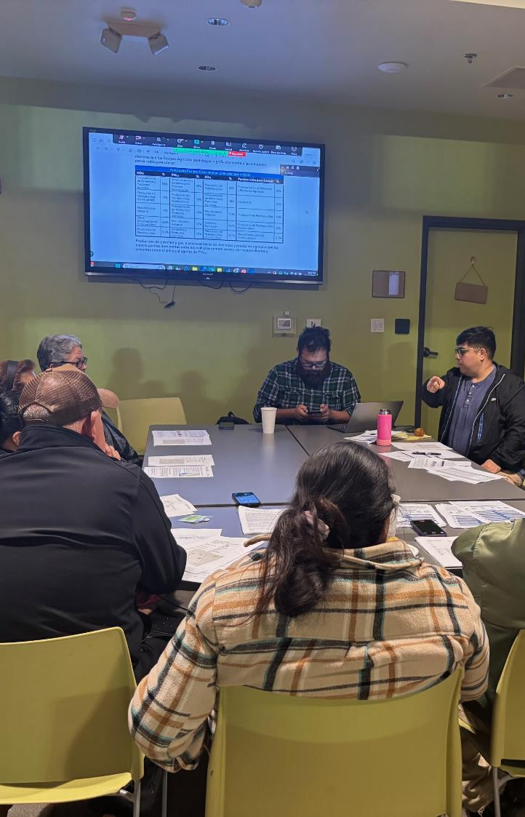
Support to CARB Community Air Grantees
DPR participates in review of CAG applications
DPR supports local community emissions reduction plans (L-CERPs) awardees.
DPR has analyzed and presented pesticide usage data for communities of
  Lost Hills
  Delano,
  Madera, and
  Stanislaus
| 36

Slide 37
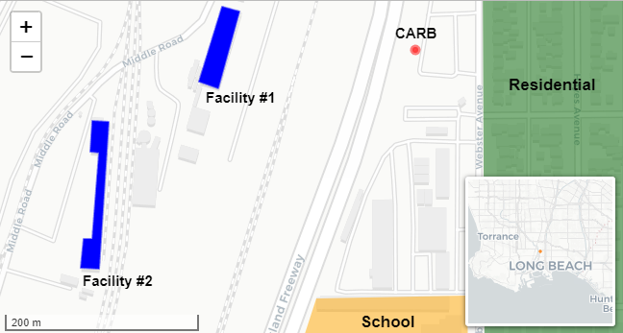
Case Study –
Long Beach
Methyl Bromide Monitoring
CARB initiated monitoring for methyl bromide in 2023 in the AB617 communities of Carson, Wilmington, and West Long Beach.
The monitoring site is located near two commodity fumigation facilities at the Port of Long Beach.
Maximum 1-hour observed concentrations neared the 1 ppm OEHHA REL, while long-term concentrations exceeded the OEHHA 1 ppb chronic REL and DPR’s 1 ppb screening level.

Slide 38
Case Study – Long Beach
Methyl Bromide Monitoring
AERMOD provided good representation of air concentrations at the CARB monitoring location.
AERMOD was used to evaluate the effectiveness of potential mitigation measures to reduce emissions.
Those mitigation measures were effectively put in place and methyl bromide concentrations at the monitor (which was transferred to the Air District) have decreased.
AERMOD showed that the position of the CARB monitor likely captured the worst-case condition.

Slide 39
Case Study – Long Beach
Methyl Bromide Monitoring
1
South Coast AQMD has initiated rulemaking to regulate emissions of commodity fumigation facilities.
2
South Coast AQMD has formed a workgroup with DPR, OEHHA, and local CACs
to provide expertise on commodity fumigants in preparation for their rulemaking.
3
DPR will continue to provide our technical expertise on use patterns, mitigation measures, and potential impacts to the workgroup.

Slide 40
Thank you!
Leia Bailey, Chief Deputy Director
Department of Pesticide Regulation
Email: Leia.Bailey@cdpr.ca.gov
Mobile: (916)247-9344
Madison H. Le, Deputy Director
Monitoring and Mitigation Division
Email: Madison.Le@cdpr.ca.gov
Mobile: (916)893-5578

